Slide 1
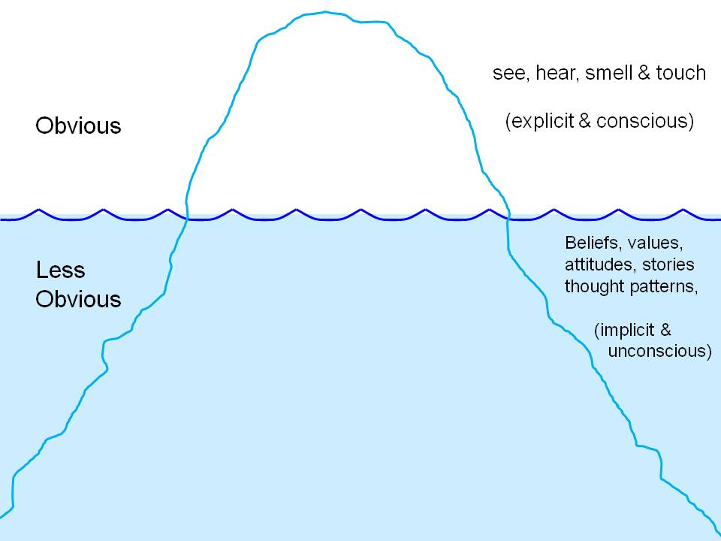
Learning Activity 3.2.2
Image 1
UN Core Pre-Deployment Training Materials 2017

Slide 2
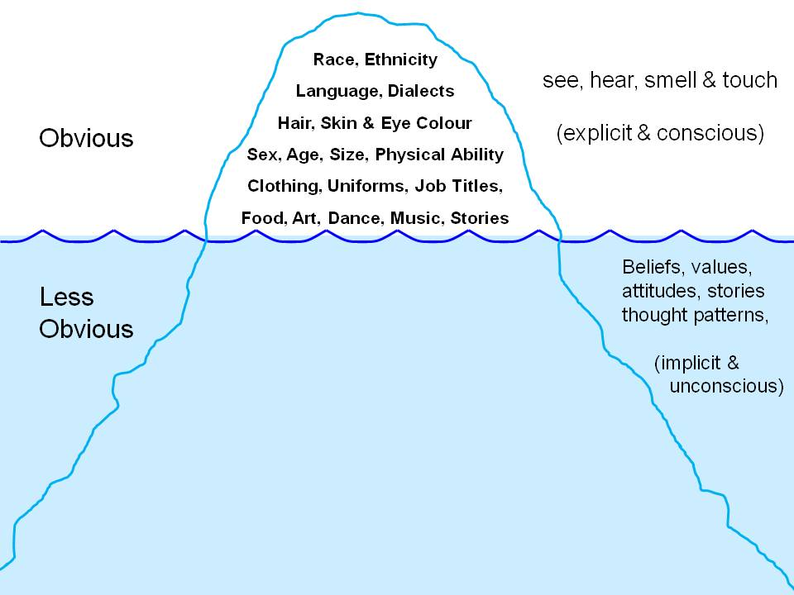
Learning Activity 3.2.2
Image 2
UN Core Pre-Deployment Training Materials 2017

Slide 3
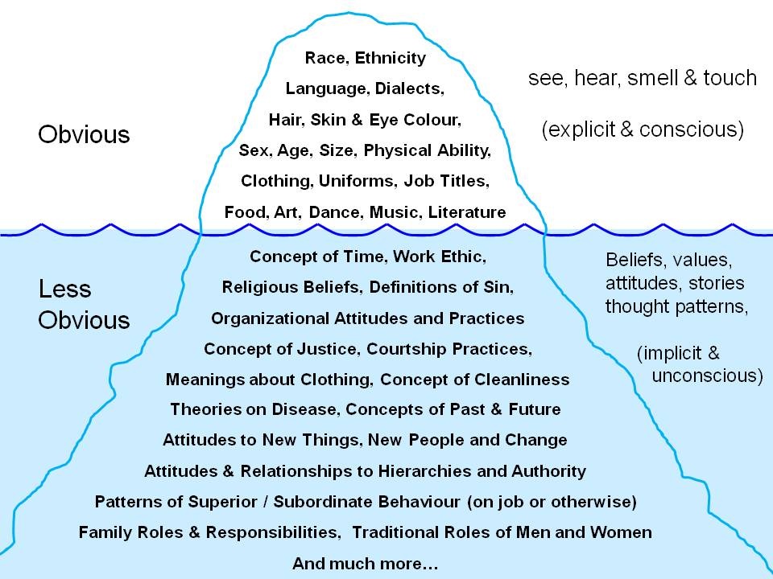
Learning Activity 3.2.2
Image 3
UN Core Pre-Deployment Training Materials 2017

